Slide 1
Daniel Mayombwe Banadda

Slide 2
I come from Uganda, Africa
Geographical scale of Uganda; Located in East Africa with an area of 241,038 square kilometres.
It has a total of 146 districts including the capital city Kampala where I was born and where my home residence is.

Slide 3
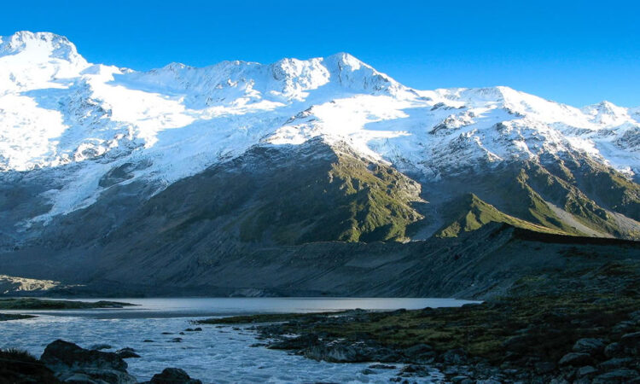
Uganda as the Pearl of Africa
Uganda is known as the Pearl of Africa because it was given this name by the British leader Winston Churchill who was amazed by the different water bodies, stunning lands/mountains, rare animals/wildlife/national parks and rich culture all contributing to its tourist attraction.
Furthermore, the Equator cuts straight across Uganda from West to East.
There are many water bodies however Lake Victoria is the most popular being the largest fresh water lake in Africa as well as the source of River Nile.
Mountains; Mt. Rwenzori which is third highest in Africa. Others include the extinct volcanic Mt. Elgon and Mt Muhavura with a crater lake at the top.

Slide 4
Climate and agriculture
Uganda has warm, tropical climate modified with high altitude.
Temperatures stay steady year-round with average daytime temperatures ranging from 24-33ºC.(75 -91ºF) while nighttime drops between 12-18ºC (54-64ºF).
There are two seasons namely; the dry and rainy seasons.
Uganda also has the following types of climate i.e. modified equatorial, mountain, tropical northern and semi arid climate.
Agriculture is the backbone of Uganda’s economy, employing roughly 70% of the working population and contributing over a quarter of the national GDP.
Availability of fertile soils and favourable climate has aided the development of the livestock sector and the growth of many crops e.g. beans, sweet potatoes, cassava, cotton, tea, cocoa and Uganda’s top export earner, coffee.

Slide 5
Ethnicity
There are over 50 distinct indigenous groups in Uganda and the four major linguistic and cultural families include; the Bantu, Nilotics, Nilo Hamites and the Sudanics

Slide 6
My Biography

Slide 7
My Academic Journey
After my primary education, in 2019 I joined King’s College Buddo (a prestigious secondary school because at its inception it was meant for kings and royals in Buganda).
One year after joining secondary school, the COVID-19 pandemic struck and for one and a half years I wasn’t going to school because of the lockdown.
Sadly, during the same period, on 1st July 2021 my father passed away following exposure to the COVID-19 Virus.
Four months after my father’s death, my mother decided that I should switch to the international study curriculum because international schools continued with studies at that time unlike schools following the Ugandan local school curriculum.
So in October 2021 with a lot of academic catching up to do as a result of the lockdown effect, I joined Kabojja International School (which follows the Cambridge International Education curriculum) in order to complete my secondary education. I sat my Year 11 in 2022 and I thank God I managed to pass despite that having been a trying/tough time of my life. In 2024, I sat my Year 13 exams which I also passed.

Slide 8
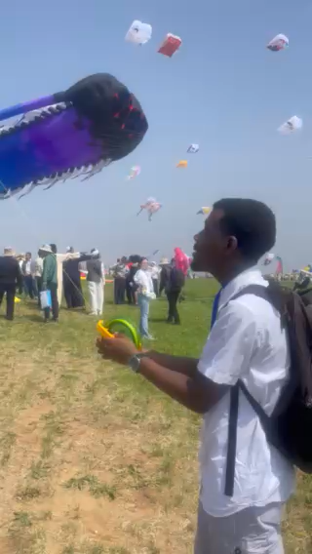
My Academic Journey continued
After completing my secondary education, I began my applications to tertiary institutions/universities, with studying in Germany as my first priority. This meant going through a hectic process requiring certification of academic transcripts, getting the ASK Certificate of Recognition without which I couldn’t apply to universities in Germany.
In 2025 while I worked on the requirements to study in Germany, I got an admission offer to a tertiary institution in Weifang, China. And so, in June 2025 my mother let me go to study in China yet she also insisted that I continue working on the prospects of studying in Germany.
During my time in Weifang, China I visited Mt. Yi, a popular mountain in Weifang, learnt how to use chopsticks, also visited a famous museum and attended this year’s Kite Festival. I would also go to church at Weifang International Christian Fellowship (WICF).

Slide 9
My Academic Journey continued
26th August 2025 - two months after going to study in China, I received the ASK Certificate of Recognition from Studienkolleg in Baden-Württemberg but I couldn‘t apply to HKA at that time beacuse admissions for the course I was interested in were not open then.
I waited until early May 2026 when the admissions application portal was open. Eight days later, I received my admission offer from HKA and embarked on completing my online enrollment and working on the German Visa application.
Indeed, it has been a very hectic past 5 years of my life but me being here makes it all worthwhile.

Slide 10
My hobbies
I like to participate in track and field events such as sprinting and relays.
I also like playing football, listening to music and singing (my family and friends say I have a great singing voice).
I also like swimming as well as cooking.

Slide 11
My Late Father’s Obituary
My Late Father, the Late Prof. Noble Ephraim Banadda, was a unique person.
He was a driven, hardworking, tough and caring man.
He is one of my biggest role models and he inspired me to push myself working with utmost determination, discipline and motivation.

Slide 12
Additional Family Information
My mother, brother and sister
My mother is the family’s breadwinner.
My siblings and I go to school but we hope that if we can excel in our education, we can help my mother.

Slide 13
THE END

